Slide 1
LOCATION BASED REAL-TIME INFORMATION DELIVERY SYSTEM
Group #6
Chandra Shekhar Jammi(95167373)
Venkata Sri Krishnakanth Pulla(95911880)
Prashant Tiwari (22721608)

Slide 2
Introduction
A novel concept of street level information delivery system.
Uses crowd sourcing to deliver highly granular information to users.
Feasible due to increased widespread use of smart mobile devices with network access.
Platform: Android
Database : MongoDB
Server: Apache and Amazon EC2 Web Service

Slide 3
Problem Statement
Services exist to provide location based information through satellites.
User cannot obtain real-time street level information. Ex: A house, a hawker etc.
There exists no cooperative crowd sourcing community to achieve this.
Building trust is important. Nobody helps others without incentive.

Slide 4
Related Work-Location Tracking
Tracking user location using compass, accelerometer and GPS. A thesis work by Mohamed Amir, Uni. Of Alexandria, Egypt.
Idea based on d = v · t+1/2* a * t2 .
V= initial location, t=time and a= acceleration.
Use GPS initially or after a tolerance threshhold and then use compass and accelerometer.

Slide 5
Related Work-Aardvark
Aims at filtering the crowd based on subscriptions of the topics.
Uses village paradigm for indexing – getting the answer to a question through nested asking.
Utilizes the social networking between the users for reliable answering – Facebook.
Builds a well-defined index tables based on the probabilities for finding the right people to answer a specific question

Slide 6
Algorithm Used

Slide 7
User Actions
Sign Up: User logs in using Facebook credentials, and as a result his friends list will be sent to server
Subscription: User subscribes to a particular location by giving relevant information about it
Ask a Question:
{User ID, location, Question,Question-Type}
Answer a Question:

Slide 8
Question Type:
  Volatile: users present at that location can answer this ex: Is there a line at Star Bucks?
  Non-Volatile: Experts about that location can answer this question ex: Is there a microwave oven in DBH?
Special Message:
  HeartBeat: Android device sends these messages periodically to server. Heartbeat messages supplies network information, current GPS location and aid in invoking necessary action by server

Slide 9
User Modes
Answering Mode: Android devise pulls questions that are addressed to user from server periodically
Default Mode: Android device pulls number of questions that are addressed to user, and displays the count

Slide 10
Data Bases: {key,value}
Experts DB
  {Location, Users Subscribed to that location}
Friends DB
  {User ID, His friends list}
Cur. Location DB
{Location, Users at that location}
Surrogates DB
  {User ID, his surrogate friends list}//people who answered his questions previously. These might get promoted to Friends DB
FAQ DB
{location, previous question-answer pairs about that location}

Slide 11
Set B
OUTPUT :{ {user1,f.c} {user2,f.c},..}
Set C
User ID:{ {user1,F.C},{user2,F.C},..}
User ID:{ {user1,F.C},{user2,F.C},..}
Friends DB
INPUT: User ID
Surrogate Friends DB
User-ID, Location, Question, Volatile/Non-Volatile
volatile
?
Expertise DB
NO
YES
Cur. Location DB
I/p:location
INPUT: location
Loc:{ {user1,E.C},{user2,E.C},..}
Loc:{ {user1,E.C},{user2,E.C},..}
Set A
Set A
Set A
OUTPUT :{ {user1,e.c} {user2,e.c},..}

Slide 12
For every user in Set A
Score = w*E.C + (1-w)*F.C is calculated
  E.C=Expertise Coefficient
  F.C=Friend Coefficient
    - Actual F.C exists only for users from Set B, Set C.
    - For all other users from Set A, F.C=default value(.25)
  w=tunable weight for expertise level
Question is sent to a user only if his score > Threshold (tunable)

Slide 13
Evaluation

Slide 14
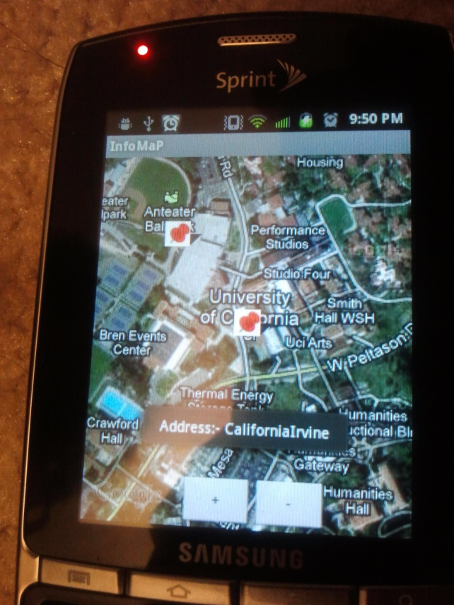
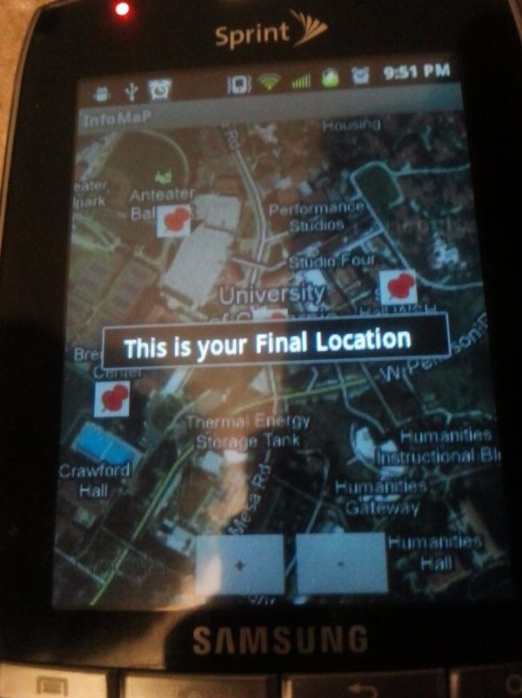
ScreenShot
Fig 1: User Enters Location
Fig 2: User Location on Map, with overlay items on screen. Use Taps to confirm final location.

Slide 15
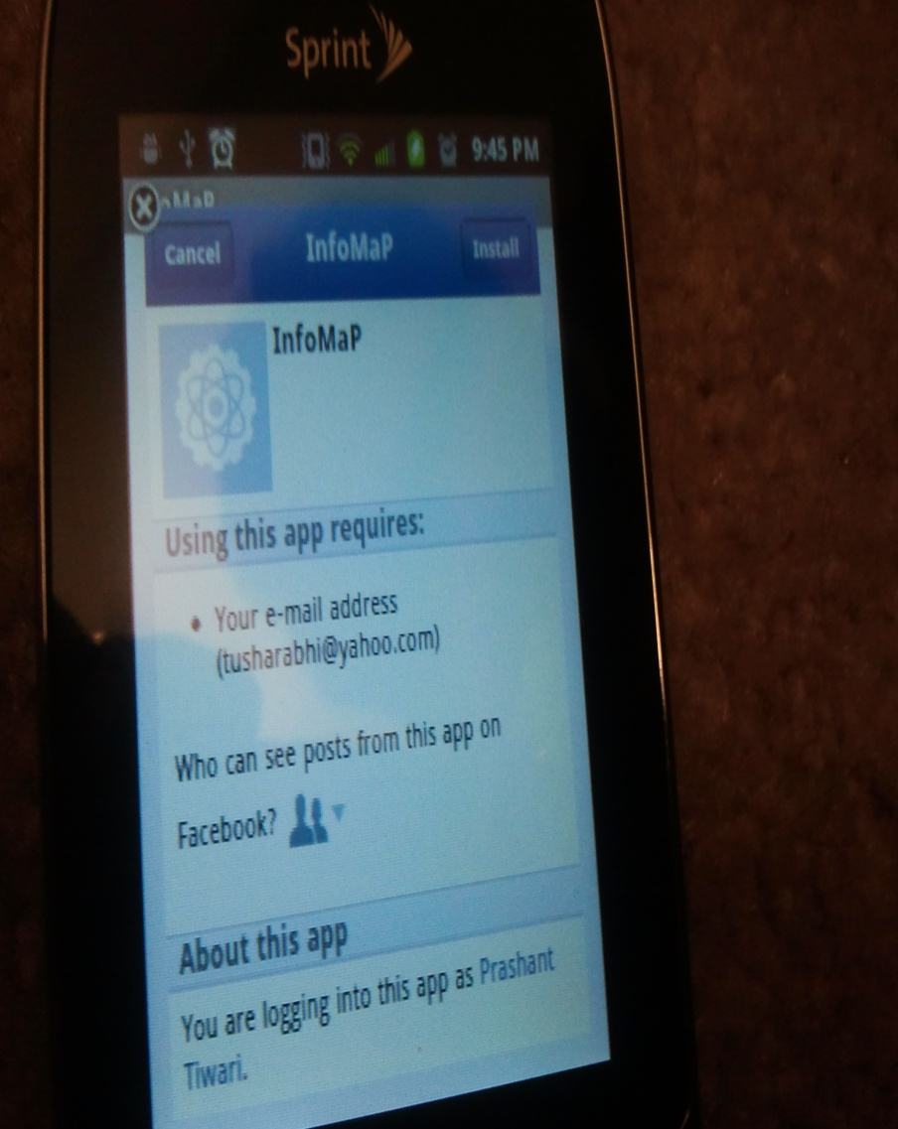
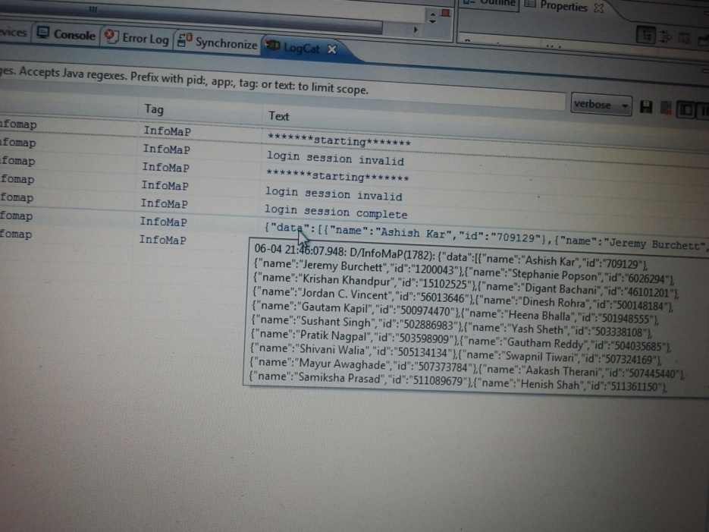
ScreenShots
Fig 4:List of User’s Friends Returned to app.
Fig 3: User Logs in to FB to give access to friends list.

Slide 16
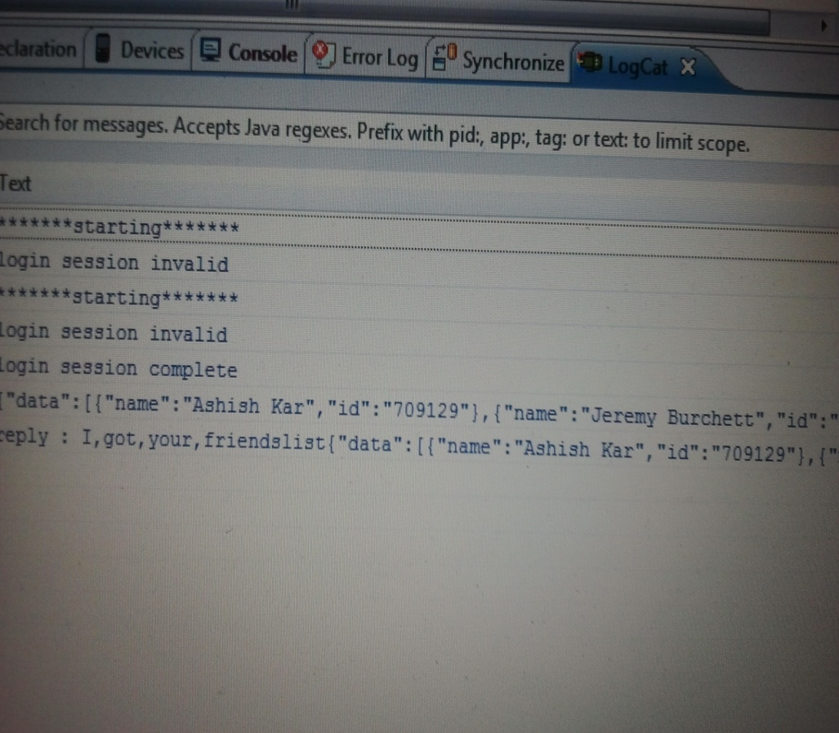
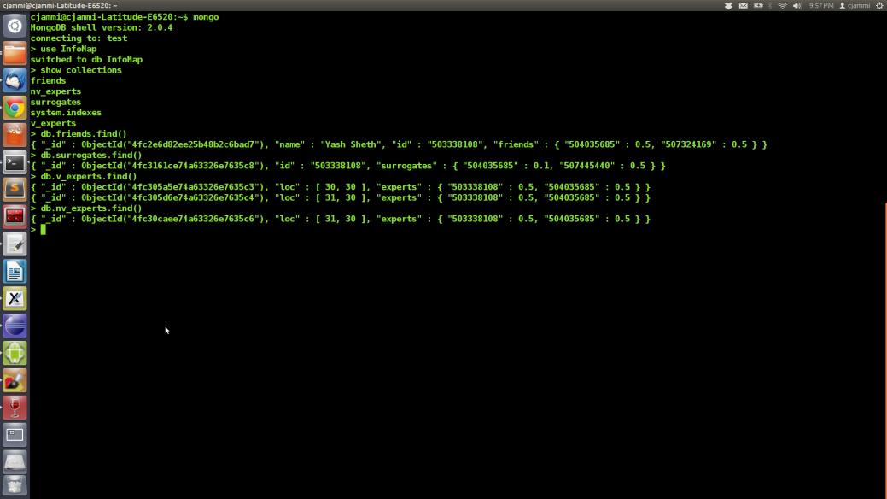
Screenshots
Fig 5: Friend List sent to user as a string, and server replies with the same list, i.e Android App is successfully talking with the Database
Fig 6: MongoDB database.

Slide 17
Conclusion
Tasks Done:
  User Subscription completed.
  User Social Graph Retrieval.
  Question’s Geospatial Reference obtained.
  User continuously tracked through GPS after every minute.
  All the above stored in database i.e Android App can talk to server on Amazon EC2.
  PHP and Python scripts interact with relevant databases, retrieve set of users to whom a given question can be sent to.

Slide 18
Conclusion
To do:
  Filter useful user of server through location proximity and expertise suggested as subscription.
  Send questions and receive answers.
  Redirect them to the user as a response.

Slide 19
Thanks

